Slide 1
Demonstration of Knowledge Translation
Paper 9
Straight from the horse’s mouth: Increasing self-report in mental health assessment in individuals with intellectual disability

Slide 2
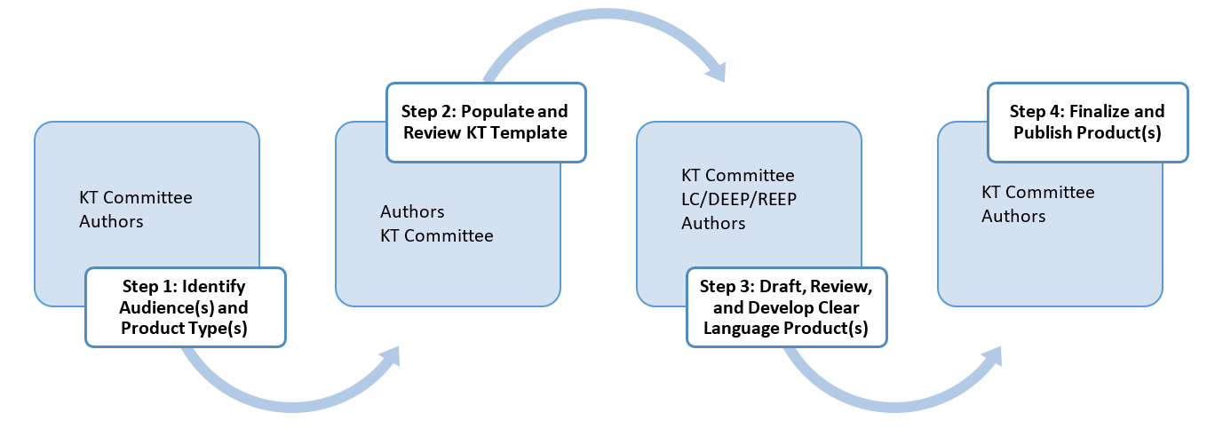
Knowledge Translation (KT) Process
You are here

Slide 3
Step 1: Identify Target Audience and Product Type
Target Audience(s) | Disability stakeholders, including individuals with intellectual and developmental disabilities (ID/DD), family members of children and adults with ID/DD, ID/DD program administrators, direct support professionals, and other health professionals
Information | Self-report is critical for mental health assessment and treatment yet is rarely available. To improve our understanding and treatment of mental health problems in individuals with ID, we must include individuals with ID
Product Type(s) | Written summary (1-2 pages)
Engagement and Accessibility | Clear language, illustrations
Dissemination | RRTC website but also explore dissemination through Mental Health Collaborative partners, maybe collaborate with SABE or other advocacy groups, ANCOR and other provider groups to reach broader audience, NADD, social media
Notes:
Authors consider target audience, key information, type of clear language product, strategies for engagement and accessibility and how to disseminate

Slide 4
Step 2: Populate and Review the KT Template
Title | Original title of the paper
Research Question(s) or Purpose | Questions that the authors wanted to answer, or the purpose of the paper
Key Findings (e.g., Results) | What the authors found by trying to answer their questions, or the key points of the paper
Main Take-Aways (e.g., Discussion) | What the authors think are the most important things that they learned through the process
Why Is This Important? (e.g., Implications, Future Research) | What the authors think about how to use what was learned or what is important to learn more about
Notes:
Authors outline information about the paper

Slide 5
Step 3: Draft, Review, and Develop Clear Language Products
Title | Clear language title | Visual supports
Research Question(s) or Purpose | Clear language questions/purpose | Visual supports
Key Findings (e.g., Results) | Translate into clear language | Add visual supports
Main Take-Aways (e.g., Discussion) | Translate into clear language | Add visual supports
Why Is This Important? (e.g., Implications, Future Research) | Translate into clear language | Add visual supports
Notes:
KT Team and DEEP work on translating the paper into clear language with visual supports

Slide 6
Translating the Title into Clear Language
Straight from the horse’s mouth:
Increasing self-report in mental health
assessment in individuals with
intellectual disability
Notes:
What does this title mean in your own words?
How would you re-phrase, re-state, or re-write this title in clear language?

Slide 7
Research Questions
1. Can people with intellectual disability self-report mental health symptoms?
2. Is it better to ask family members or DSPs about the mental health of adults with ID?
3. What should be done to make mental health assessment more accessible?
Notes:
What words or ideas are hard-to-understand?
How would you re-state these questions?

Slide 8
Key Findings
1. Most adults with intellectual
disability can provide accurate
mental health information with
appropriate supports.
Notes:
What does this mean in your own words?
What words or ideas are hard-to-understand?
How would you re-phrase, re-state, or re-write this title in clear language?
What pictures or images would help you or someone else better understand this idea?

Slide 9
Key Findings
2. Other informants, like family members or DSPs, can provide helpful mental health information but only if:
they know the individual very well
they are asked about things they can
see (how they are eating or sleeping)
Notes:
What does this mean in your own words?
What words or ideas are hard-to-understand?
How would you re-phrase, re-state, or re-write this title in clear language?
What pictures or images would help you or someone else better understand this idea?

Slide 10
Key Findings
3. ID/DD expertise is needed to combine information from self-report and information from others.
Notes:
What does this mean in your own words?
What words or ideas are hard-to-understand?
How would you re-phrase, re-state, or re-write this title in clear language?
What pictures or images would help you or someone else better understand this idea?

Slide 11
Key Findings
4. The individual him/herself is the best
person to report their feelings, worries,
or happiness.
Notes:
What does this mean in your own words?
What words or ideas are hard-to-understand?
How would you re-phrase, re-state, or re-write this title in clear language?
What pictures or images would help you or someone else better understand this idea?

Slide 12
Key Findings
5. Designing cognitively accessible self-report measures increases valid self-reporting.
Notes:
What does this mean in your own words?
What words or ideas are hard-to-understand?
How would you re-phrase, re-state, or re-write this title in clear language?
What pictures or images would help you or someone else better understand this idea?

Slide 13
Key Findings
6. These strategies can make self-report measures cognitively accessible.
a. Take time to get to know the person and build trust before asking personal questions
Notes:
What does this mean in your own words?
What words or ideas are hard-to-understand?
How would you re-phrase, re-state, or re-write this title in clear language?
What pictures or images would help you or someone else better understand this idea?

Slide 14
Key Findings
b. Give the person enough time to respond to questions
Notes:
What does this mean in your own words?
What words or ideas are hard-to-understand?
How would you re-phrase, re-state, or re-write this title in clear language?
What pictures or images would help you or someone else better understand this idea?

Slide 15
Key Findings
c. explain and respect confidentiality
Notes:
What does this mean in your own words?
What words or ideas are hard-to-understand?
How would you re-phrase, re-state, or re-write this title in clear language?
What pictures or images would help you or someone else better understand this idea?

Slide 16
Key Findings
d. give participants a chance to practice using the rating scales to improve understanding and communication
Notes:
What does this mean in your own words?
What words or ideas are hard-to-understand?
How would you re-phrase, re-state, or re-write this title in clear language?
What pictures or images would help you or someone else better understand this idea?

Slide 17
Key Findings
e. use short words and simple sentences (about a 4th grade reading level)
Notes:
What does this mean in your own words?
What words or ideas are hard-to-understand?
How would you re-phrase, re-state, or re-write this title in clear language?
What pictures or images would help you or someone else better understand this idea?

Slide 18
Key Findings
f. use clear phrases. For example, I am often tired is better than I have no energy.
Notes:
What does this mean in your own words?
What words or ideas are hard-to-understand?
How would you re-phrase, re-state, or re-write this title in clear language?
What pictures or images would help you or someone else better understand this idea?

Slide 19
Key Findings
g. When asking about when things happened, use important anchoring events, like a birthday or holiday, instead of dates or time periods
Notes:
What does this mean in your own words?
What words or ideas are hard-to-understand?
How would you re-phrase, re-state, or re-write this title in clear language?
What pictures or images would help you or someone else better understand this idea?

Slide 20
Key Findings
h. Ask about specific activities or events instead of general questions
Notes:
What does this mean in your own words?
What words or ideas are hard-to-understand?
How would you re-phrase, re-state, or re-write this title in clear language?
What pictures or images would help you or someone else better understand this idea?

Slide 21
Key Findings
i. Extra care and trust is needed when asking about sensitive or taboo topics. Reassure participants that their answers will not be shared with family or service workers.
Notes:
What does this mean in your own words?
What words or ideas are hard-to-understand?
How would you re-phrase, re-state, or re-write this title in clear language?
What pictures or images would help you or someone else better understand this idea?

Slide 22
Key Findings
j. Take breaks, summarize information
Notes:
What does this mean in your own words?
What words or ideas are hard-to-understand?
How would you re-phrase, re-state, or re-write this title in clear language?
What pictures or images would help you or someone else better understand this idea?

Slide 23
Main Take-Aways
1. Individuals with ID are the best source of information about their own mental health
Notes:
What does this mean in your own words?
What words or ideas are hard-to-understand?
How would you re-phrase, re-state, or re-write this title in clear language?
What pictures or images would help you or someone else better understand this idea?

Slide 24
Main Take-Aways
2. Researchers need to shift from informant report to fully engage adults with ID to provide first-hand information about mental health
Notes:
What does this mean in your own words?
What words or ideas are hard-to-understand?
How would you re-phrase, re-state, or re-write this title in clear language?
What pictures or images would help you or someone else better understand this idea?

Slide 25
Main Take-Aways
3. Including adults with ID in mental health research can help develop more accessible and worthwhile measures
Notes:
What does this mean in your own words?
What words or ideas are hard-to-understand?
How would you re-phrase, re-state, or re-write this title in clear language?
What pictures or images would help you or someone else better understand this idea?

Slide 26
Why Is This Important?
1. Listening to the voice of adults with ID is needed to understand their mental health
Notes:
What does this mean in your own words?
What words or ideas are hard-to-understand?
How would you re-phrase, re-state, or re-write this title in clear language?
What pictures or images would help you or someone else better understand this idea?

Slide 27
Why Is This Important?
2. Better measures are needed to obtain self-reported mental health information from adults with ID/DD
Notes:
What does this mean in your own words?
What words or ideas are hard-to-understand?
How would you re-phrase, re-state, or re-write this title in clear language?
What pictures or images would help you or someone else better understand this idea?

Slide 28
What are the most important ideas to share?
Notes:
What do you think are the most important ideas from this paper that we need to share with others?

Slide 29
What ides do you have to display the information?
Notes:
How would you display, organize, and/or share the most important information with others?

