Slide 1
The OSU Nisonger RRTC Knowledge Translation Process
Andrew Buck, PhD, Research Scientist
Christine Brown, Clinical Research Assistant, LEND Self-Advocate Faculty
The Ohio State University Nisonger Center

Slide 2
What is Knowledge Translation (KT)?
KT is an iterative revision process between stakeholders that makes technical information more accessible, usable, and clear for more people.
Technical Knowledge
Hard to Access & Understand
Knowledge
Translation
Clear Language
Lower Reading Level
Easier to Access & Understand
High Reading Level
Reduce Reading Level
Ask Many People for Input to Make It Better
Improve Visual Display
Not Accessible or Usable for Many People
Accessible and Usable for More People

Slide 3
What is the Purpose of KT?
The purpose of knowledge translation is to increase accessibility, comprehension, and usability of information by a broad audience, including:
Individuals with intellectual and developmental disabilities and their family members
English language learners, neurodiverse learners, multi-modal learners
Knowledge translation incorporates Universal Design for Learning adaptations, modifications, and multi-modal mediums and strategies that improve information dissemination and consumption for diverse learners (CAST, 2020).

Slide 4
Why is KT Important?
Everyone has the right to access, learn, and use information that is important for them to be an informed citizen and live a healthy life.
Information that is easier to understand helps people make better choices on issues such as education, employment, and healthcare (UKDH, 2010)
The public deserves information that makes sense to them, and many studies have shown that providing clear information can save time, personnel resources, and money while giving better service to your audience and stakeholders (PLAIN, n.d.)

Slide 5
Knowledge Translation Terms

Slide 6
Common KT Terminology
Plain Language
Writing that is clear, concise, and well-organized
Active voice, short sentences, common words, easy-to-follow design features (e.g., headers, lists) and formatting to support visual clarity
Plain Language Action and Information Network: https://www.plainlanguage.gov/
A Plain Language Checklist for Reviewing Your Document (NIH, 2013)

Slide 7
Common KT Terminology
Easy Read
Information that is clear and easy to read and understand
Active voice, short sentences, larger font size, glossary to define jargon and abbreviations, use of color or bold type and pictures to support meaning
Accessible Communication Formats: https://www.gov.uk/
Making written information easier to understand for people with learning disabilities (UKDH, 2010)

Slide 8
Common KT Terminology
Clear Language
Clear and simple writing that an audience can understand quickly and easily
Present information in logical order, use common words and visual presentation to enhance the text (e.g., spacing; bold, highlight, underline; and images with alt text)
Clear Language and Presentation Principles and Guidelines. https://www.canada.ca/
Clear language and design guidelines (THRSC, 2015)

Slide 9
Our Project’s Preferred KT Term
We consulted our research partners with lived disability experience
The majority preferred the term “clear language” to describe our knowledge translation process:
“Plain Language” sounded too bland, boring, and ... plain.
“Easy Read” sounded condescending for an adult audience.
“Clear Language” sounded appealing and appropriate for our purpose (i.e., to make research and technical information more clear for people to access, learn, and use.

Slide 10
Clear Language Products
Clear language adaptations, modifications, and multi-modal strategies include:
Visual formatting with a combination of text & media or graphical organization of information.
Adapted reading level, which calculates a Flesch-Kincaid Readability Statistic at or below 6th grade.
Formatted text that incorporates emboldened, underlined, highlighted, CAPTITALIZED and/or color-coded text to EMPHASIZE text or enhance visual display of information.

Slide 11
Clear Language Products
Clear language adaptations, modifications, and multi-modal strategies include:
Alt text, which describes images, icons, charts, and other visual information that is relevant to comprehension.
Accessibility features that leverage alt text, plain text, Word document styles, and other means to establish access via assistive technology, like screen readers.
Larger font size (e.g., 16+ point), which supports all readers regardless of visual impairment.

Slide 12
Clear Language Products
Clear language products may vary in format and length.
Some examples include:
Papers with adapted and formatted text supported by images, icons, visuals with alt text or other multi-media, including hyperlinks and embedded videos:
1-2 page infographics or briefs
4-6 page summaries
10+ page short papers
Audio/visual media supported by closed captions, transcript files with adapted and formatted text, and audio description.

Slide 13
Clear Language Products
Identifying the target audience(s) supports the selection of appropriate clear language products. For example:
If the target audience is individuals with intellectual disability, then an audio/visual product or 1-2 page brief with 3rd-4th grade reading level and formatting that supports screen readers may be the best option to increase accessibility and comprehension.
If the intended audience is family members, support staff, or service providers of individuals with disabilities, then a 4-6 page summary or 10+ page short paper with additional details and 6th grade reading level may be appropriate.

Slide 14
Clear Language Products
In cases of dissemination to multiple audiences, the development of different product types or levels may best support access and comprehension for diverse stakeholders.
For example, a 10+ page short paper intended for service providers (e.g., level 1) may be broken down into:
4-6 page summary paper for families (e.g., level 2)
1-2 page brief or infographic or short video for individuals with ID/DD (e.g., level 3).
In this example, translation results in 3 products intended for different audiences.

Slide 15
Key Strategies for Knowledge Translation

Slide 16
Academic Accommodations for Neurodiverse and Neurodivergent Learners
Universal Design for Learning: https://udlguidelines.cast.org/
Provide multiple means of:
Engagement (e.g., choice, autonomy, collaboration, self-regulation)
Representation (e.g., audio-visual alternatives, clarification, comprehension)
Action & Expression (e.g., vary methods for response, assistive technology, multiple media and tools for communication, construction, composition, executive functioning skills)

Slide 17
Academic Accommodations
Common syllabus example
Cheating / Plagiarism: Plagiarism refers to the reproduction of another's words or ideas without proper attribution. University Regulations contains further information on dishonesty. Plagiarism and other forms of academic dishonesty are serious offenses and will be treated as such in this class. You are expected to produce your own work and to accurately cite all necessary materials. Cheating, plagiarism, and other dishonest practices will be punished as harshly as [the school’s] policies allow. Any instances of academic dishonesty will likely result in a grade of F for the course and notification of the Dean of Students Office.

Slide 18
Academic Accommodations
Common syllabus example translated
Cheating / Plagiarism:
Plagiarism is a type of cheating.
It means using someone’s words or ideas as your own.
It is like stealing something that does not belong to you.
You must cite a person, or source of information, if you use their words or ideas in your work. This gives them credit.
Watch the following video to learn more about citing sources of information: https://youtu.be/-JV9cLDCgas
You can talk to your teacher or peer mentor about how to cite your sources.
You can go to the Library or Student Success Center to ask for help.
Cheating in school is very bad. You can fail a class. You can get kicked out of school.

Slide 19
Know Your Audience
Before determining the type of clear language product to develop, it is important to identify the target audience.
Recommended questions for authors of clear language products to address include:
Who is the primary audience, or are there multiple audiences?
What do they need to know, and how much detail do they need?
What type of product or medium is preferred or suggested by the audience?
How will the product engage the audience and ensure the information is clear?
Where and how will the product be disseminated to reach the target audience?
(National Institute of Health, 2013)

Slide 20
Know Your Audience
Plain language, easy read, or clear language “should be developed in consultation with your audience.”
“Talk to users and ask them what they need and want.”
“Involve [individuals with disabilities] from your audience in developing and reviewing a strategy for producing information in accessible formats. They will know their needs and could help you find the most effective ways of meeting them. You can also approach disability organisations for advice.”

Slide 21
Test Your Content
“Test, make corrections based on feedback, and test again. Plan to test at least twice. This process of testing, revising, and re-testing is called ‘iteration.’ Iteration is part of what makes usability testing so effective.”
“Ask people with learning disabilities what they think and if they understand the document before it is published.”
“Seek feedback through focus groups and surveys. Use a checklist to ensure that clear language and presentation principles were followed.”

Slide 22
Test Your Content
Paraphrase testing
Ask participants to read and review a specific section.
Ask them to tell you what the section means in their own words.
Ask them what words or ideas might cause problems for other people.
Identify confusion and misunderstood messages, fix the problem, and re-test.
https://www.plainlanguage.gov/guidelines/test/

Slide 23
Test Your Content
Usability testing
Tell participants that they have a need to find specific information.
Observe them as they review materials to locate and explain what they found.
Ask them about the experience, including specific words or phrases.
Identify difficulties in navigation or comprehension, revise, and re-test.
https://www.plainlanguage.gov/guidelines/test/

Slide 24
Test Your Content
Interviews
Paraphrase testing (6 – 9 individual interviews)
Usability testing (3 individual sessions)
Co-discovery with 2 participants working together
Several people working independently
Comparative testing with different versions of your document or information
Remote moderated or unmoderated testing tools
Focus group discussions
https://www.plainlanguage.gov/guidelines/test/

Slide 25
Review Your Content
NIH – A Plain Language Checklist for Reviewing Your Document: https://www.nih.gov/sites/default/files/institutes/plain-language/nih-plain-language-checklist.pdf

Slide 26
The OSU RRTC Knowledge Translation Process

Slide 27
The OSU Nisonger RRTC Model
The research project’s Learning Collaborative (LC) is comprised of two groups:
Research Experience Expert Panel (REEP)
Disability Experience Expert Panel (DEEP)
REEP
DEEP
LC
LEARNING COLLABORATIVE

Slide 28
Research Experience Expert Panel (REEP)
The REEP is a group of individuals with disability research experience who serve as partners on the OSU Nisonger RRTC project.
Give input across the research process (e.g., meetings, surveys, consultation)
Support knowledge production and help write technical publications

Slide 29
Disability Experience Expert Panel (DEEP)
The DEEP is a group of individuals with lived disability experience who serve as research partners on the OSU Nisonger RRTC project.
Give input across the research process (e.g., surveys, focus group meetings)
Support knowledge translation and help make clear language products

Slide 30
OSU RRTC Knowledge Translation (KT) Process
Step 2: Populate and Review KT Template
REEP Authors
Step 3: Draft, Review, and Develop Clear Language Product(s)
Step 4: Finalize and Publish Product(s)
Project Staff
REEP Authors
Step 1: Identify Audience(s) and Product Type(s)
Project Staff
Project Staff
Project Staff
LC/DEEP/REEP
REEP Authors
REEP Authors

Slide 31
KT Process
Step 1: Identify the Audience(s) and Product Type(s)
The KT Process begins with the publication of an article or other academic, scientific, or technical product.
Project staff initiate the process by communicating with the authors to schedule a meeting to discuss target audience(s) and product type(s) that are appropriate for translation and dissemination.
Use a KT Template to document decisions and move the process to the next step.

Slide 32
KT Process
Step 2: Populate and Review the KT Template
Authors (recommended) or project staff populate the KT Template:
Original Title (Paraphrased Title, if needed)
Original Research Questions (Paraphrased Questions, if needed)
Key Findings (e.g., Results)
Main Take-Aways (e.g., Discussion)
Why Is This Important? (e.g., Implications for Future Research)
The team may decide to customize the organization or amount of information for each part depending on the identified audience(s) or product type(s).

Slide 33
KT Process
Step 2: Populate and Review the KT Template (continued)
Authors (recommended) or project staff present KT Template to DEEP.
This meeting allows the authors to present their work to the DEEP and is intended to facilitate teamwork, identify challenging vocabulary and concepts, discuss appropriate clear language translations of technical content, and brainstorm visuals to support comprehension.
Results of this meeting will support an initial draft of the clear language product.

Slide 34
KT Process
Step 3: Draft, Review, and Develop Clear Language Product(s)
Project staff (recommended) and/or authors use clear language strategies and methods to draft product(s)
Iterative feedback is acquired from the Learning Collaborative through additional communication (e.g., follow-up meetings, surveys, emails) and used to test, revise and re-test the product(s)

Slide 35
KT Process
Step 3: Draft, Review, and Develop Clear Language Product(s) (continued)
Authors ensure the translation is accurate and comprehensive, and DEEP ensures the translation is accessible and clear through the iterations.
A final meeting is recommended where DEEP presents the product to the authors to confirm an accurate and satisfactory translation of the original work.
If not, feedback is used to develop and test further iterations.

Slide 36
KT Process
Step 4: Finalize and Publish the Product(s)
Project staff presents final product to the entire Learning Collaborative
A final opportunity to gather feedback or recommendations for revision.
Final products should include original citation or reference
Published to the OSU RRTC website and disseminated through appropriate venues to reach target audience(s)

Slide 37
OSU RRTC Examples

Slide 38
OSU Nisonger RRTC Clear Language Products
Clear Language Products: https://www.rrtcnisonger.org/products/clear-language/

Slide 39
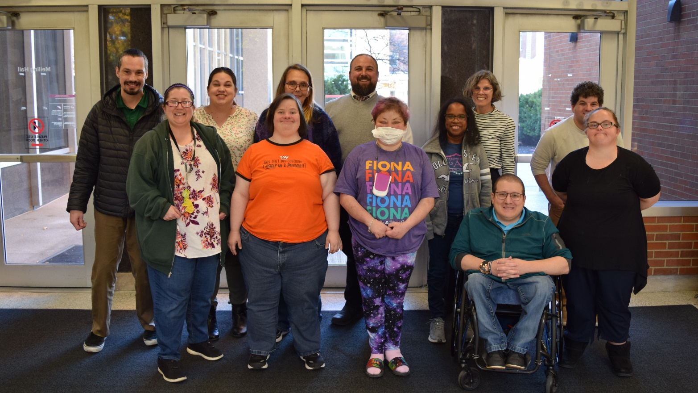
ACL ID/DD Counts Project and 10-Year Roadmap
The Administration for Community Living (ACL) engaged the DEEP in a knowledge translation activity:

Slide 40
ACL ID/DD Counts Project and 10-Year Roadmap
An iterative revision process between stakeholders...
ACL drafted a plain language outline of a technical report and sent to OSU staff
OSU reduced readability level and sent the simplified outline back to ACL
ACL revised to improve translation
OSU drafted a clear language product and presented to DEEP in a meeting with ACL
DEEP gave feedback to improve text and visual presentation
OSU created 12-, 4-, and 2-page products through iterative feedback loops

Slide 41
ACL ID/DD Counts Project and 10-Year Roadmap
“All the changes that were made make [the product] look and sound much better […] I’m so proud to see all the work we have accomplished so far and what we can do with it in the future.” –DEEP Member

Slide 42
AAIDD Translational Video Examples

Slide 43
AAIDD Translational Videos
September 2020 Example
August 2020 Example

Slide 44
Additional Resources and Examples

Slide 45
Additional Resources
Association of University Centers on Disabilities – ABCs of Plain Language: https://www.aucd.org/docs/ABCs%20of%20Plain%20Language_final.pdf
Autistic Self-Advocacy Network – One Idea Per Line: A Guide to Making Easy Read Resources: https://autisticadvocacy.org/resources/accessibility/easyread/
Green Mountain Self-Advocates – Plain Language Checklist: https://gmsavt.org/wp-content/uploads/2019/08/Plain-Language-Checklist.pdf

Slide 46
Additional Resources
National Institutes of Health – Plain Language: Getting Started or Brushing Up: https://www.nih.gov/institutes-nih/nih-office-director/office-communications-public-liaison/clear-communication/plain-language/plain-language-getting-started-or-brushing
Plain Language Action and Information Network: https://www.plainlanguage.gov/
Plain Language Center – Five Steps to Plain Language: https://centerforplainlanguage.org/learning-training/five-steps-plain-language/

Slide 47
Additional Resources
Self-Advocates Becoming Empowered – Guide for Creating Cognitively Accessible Language: https://www.sabeusa.org/wp-content/uploads/2014/02/GuideToCreatingAccessibleLanguage.pdf
Self-Advocacy Resource and Technical Assistance Center – Plain Language Formats Webinar: https://youtu.be/1XIjLTG5_uQ
The Center for Universal Design in Education: https://www.washington.edu/doit/programs/center-universal-design-education/overview

Slide 48
Additional Examples
Centre for Addiction and Mental Health – Online Course to Improve the Mental Health of People with Intellectual Disabilities (ID) During COVID-19: A Research Study: https://go.osu.edu/CAMHsample
Centre for Addiction and Mental Health – Research Study: Virtual Mindfulness Groups: Are They Helpful for Autistic Adults? https://go.osu.edu/CAMHsample2

Slide 49
Additional Examples
Think College – Plain Language Series: https://thinkcollege.net/think-college-news/critical-topics-covered-in-new-think-college-plain-language-series
University Centers for Excellence in Developmental Disabilities – Plain Language and Easy Read: https://www.aucd.org/template/page.cfm?id=1207

